Slide 1

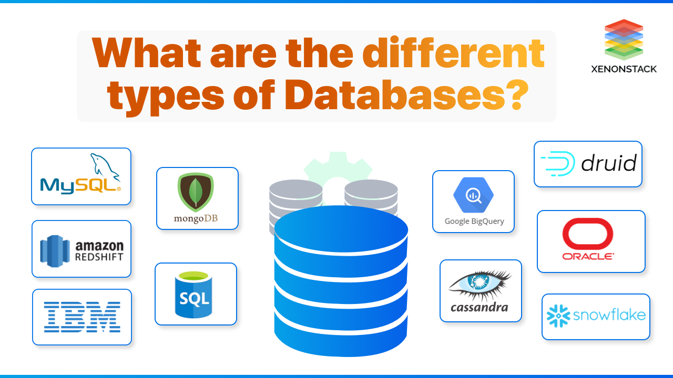
Checkpoint :Introduction to Databases
Presented by Hana Achour

Slide 2
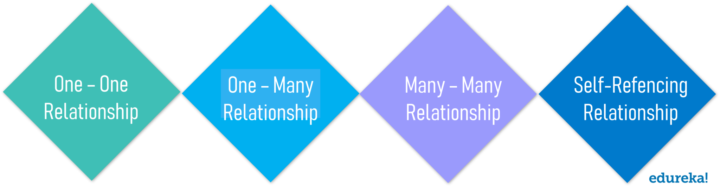
SQL aka Structured Query Language is the core of the relational database which is used for accessing and managing the databases. This language is used to manipulate and retrieve data from a structured data format in the form of tables and holds relationships between those tables. The relations could be as follows:
A One-to-One Relationship is when a single row in Table A is related to a single row in Table B.
A One-to-Many Relationship is when a single row in Table A is related to many rows in table B.
A Many-to-Many Relationship is when many rows in table A can be related to many rows in table B.
A Self -Referencing Relationship is when a record in table A is related to the same table itself.

Slide 3
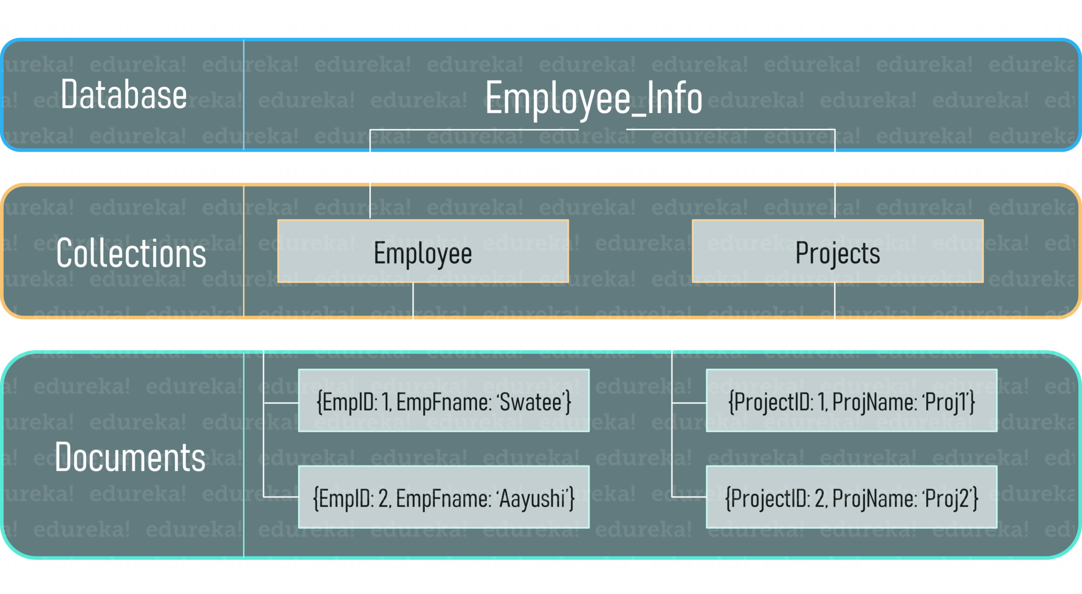
What is NoSQL?
NoSQL, or most commonly known as Not only SQL database, provides a mechanism for storage and retrieval of unstructured data. This type of database can handle a humongous amount of data and has a dynamic schema. So, a NoSQL database has no specific query language, no or a very few relationships, but has data stored in the format of collections and documents.
So, a database can have a ‘n’ number of collections and each collection can have ‘m‘ number of documents.

Slide 4
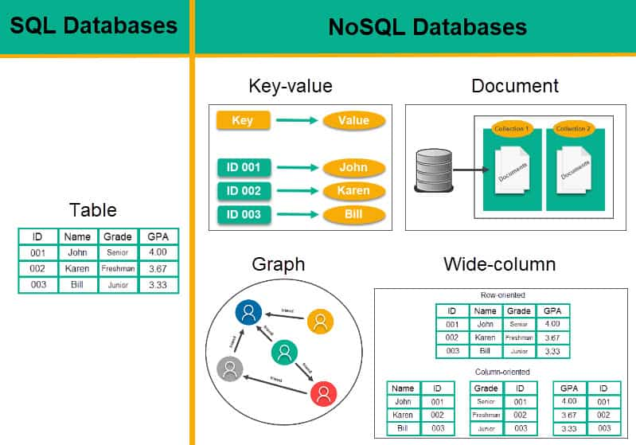

Slide 5
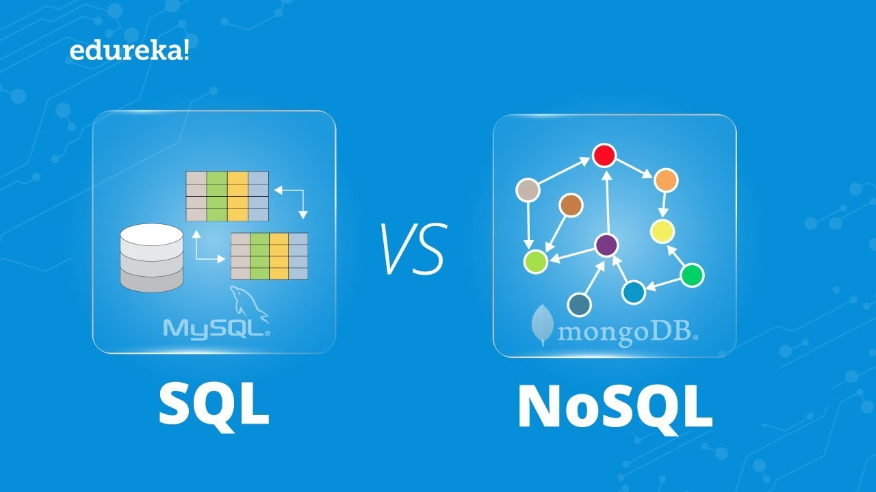
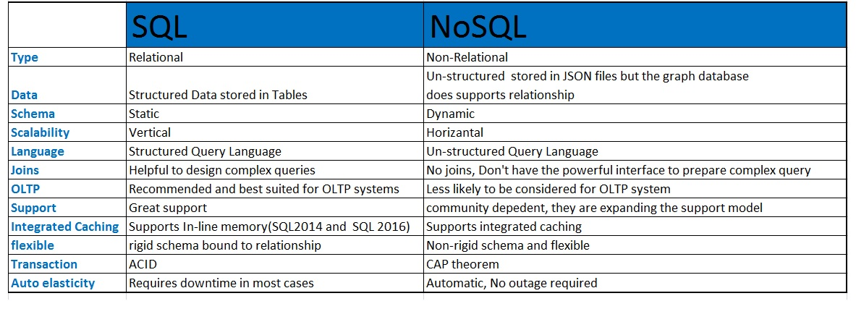

Slide 6
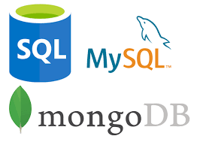
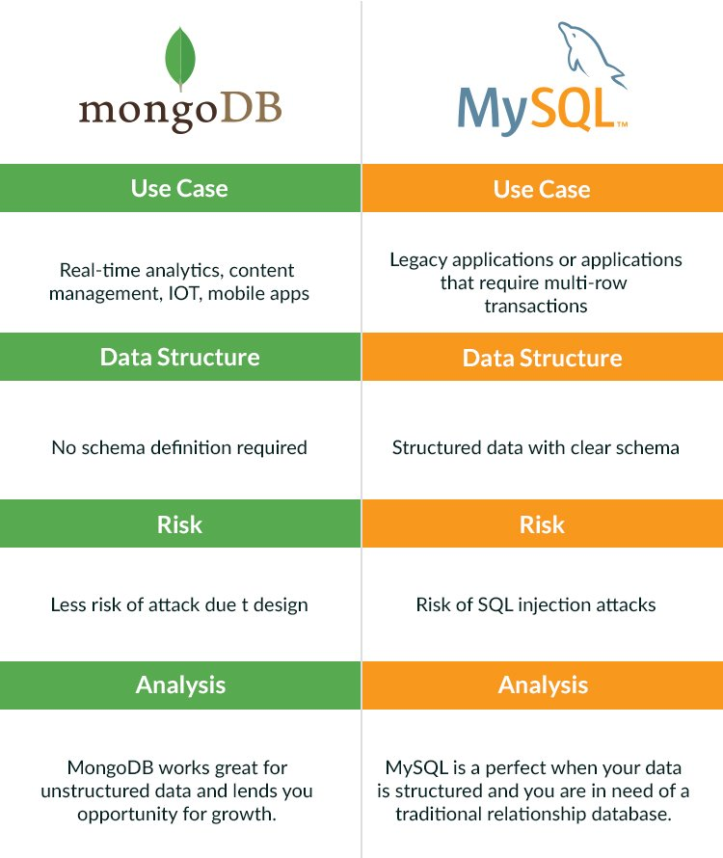
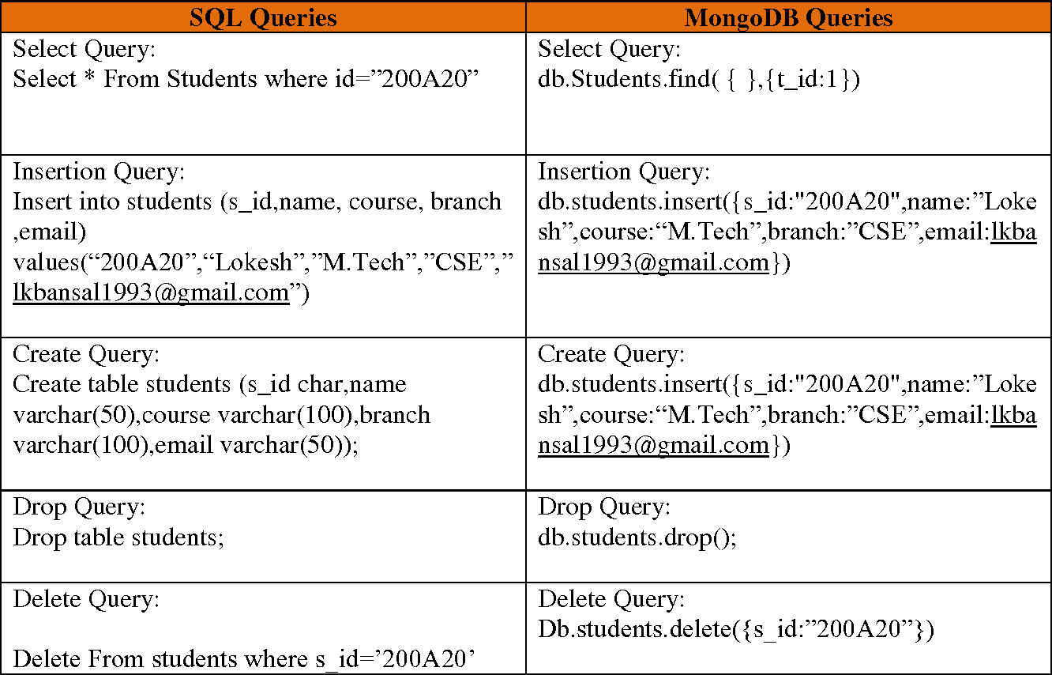
Cases of use

